Slide 1

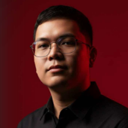

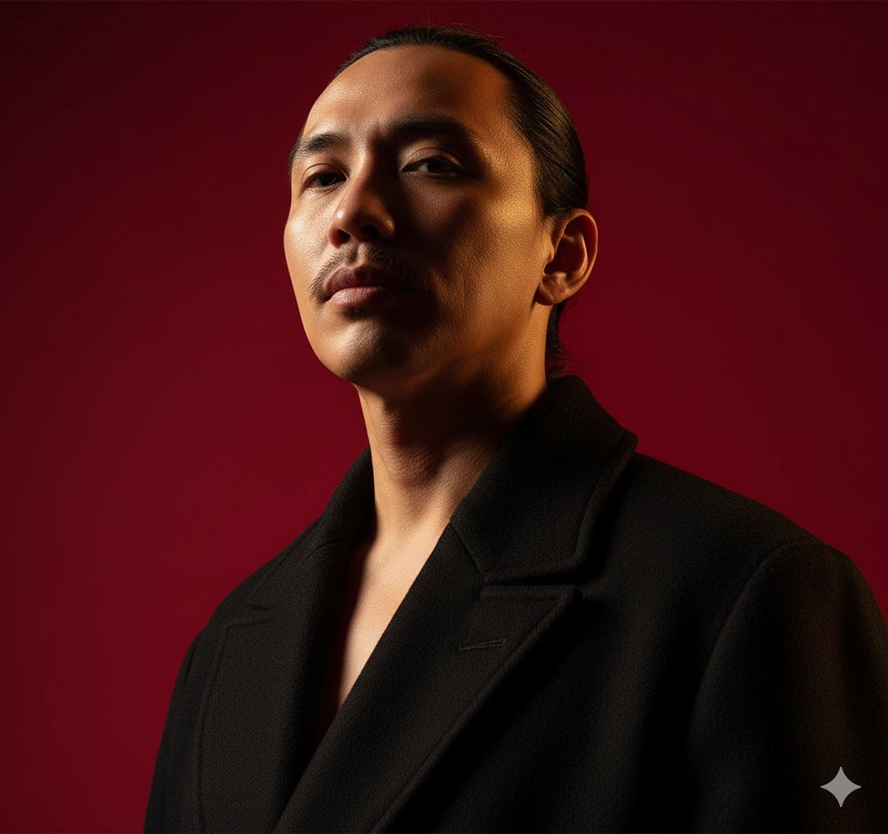


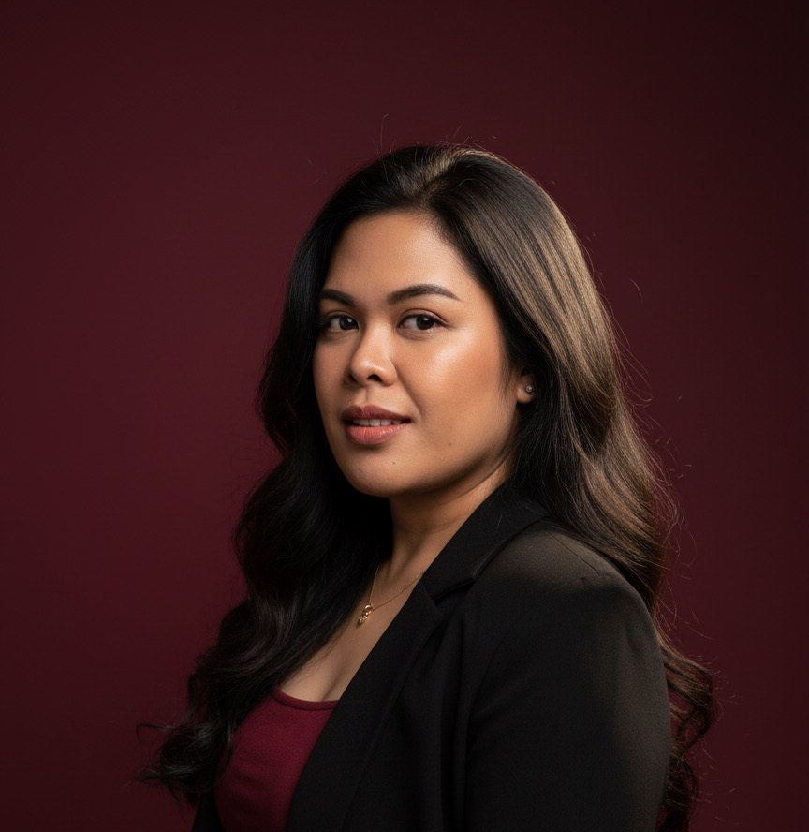




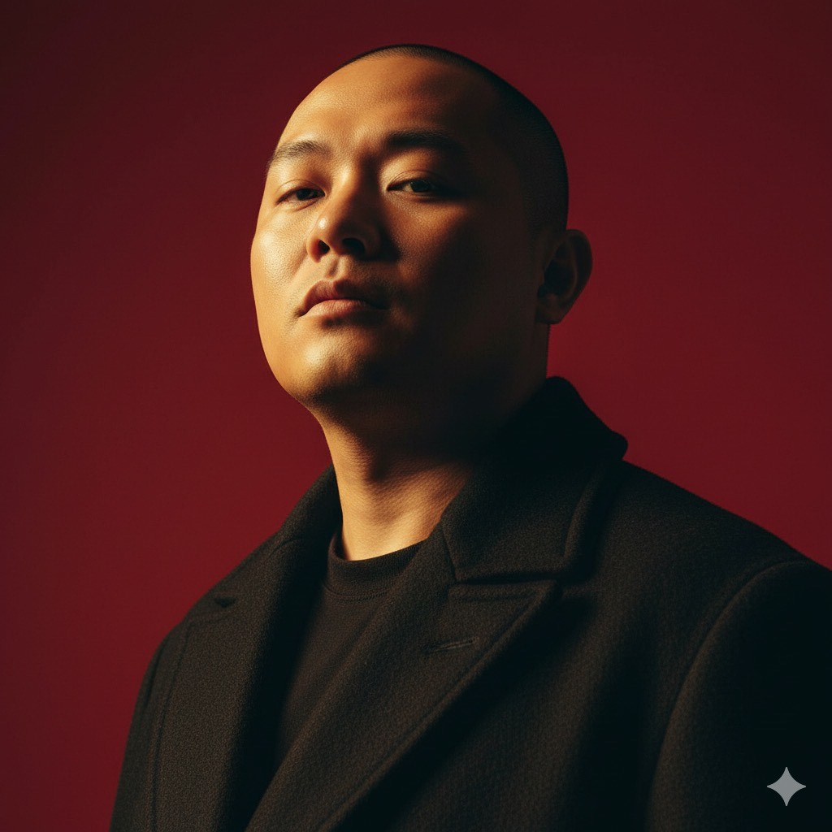


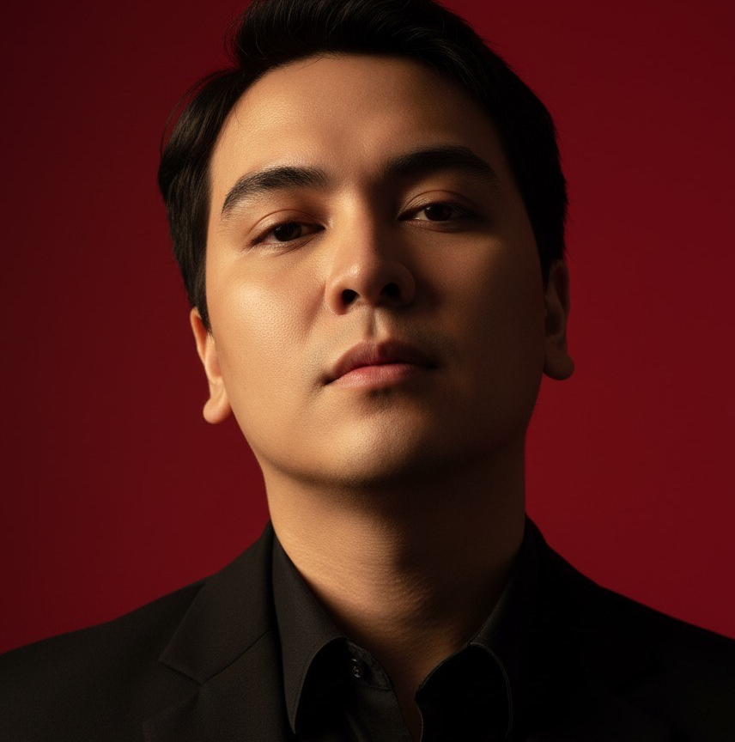
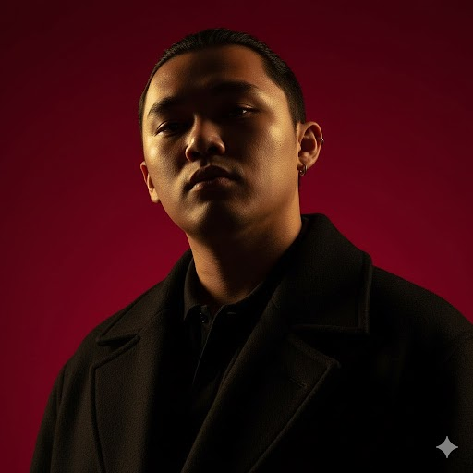





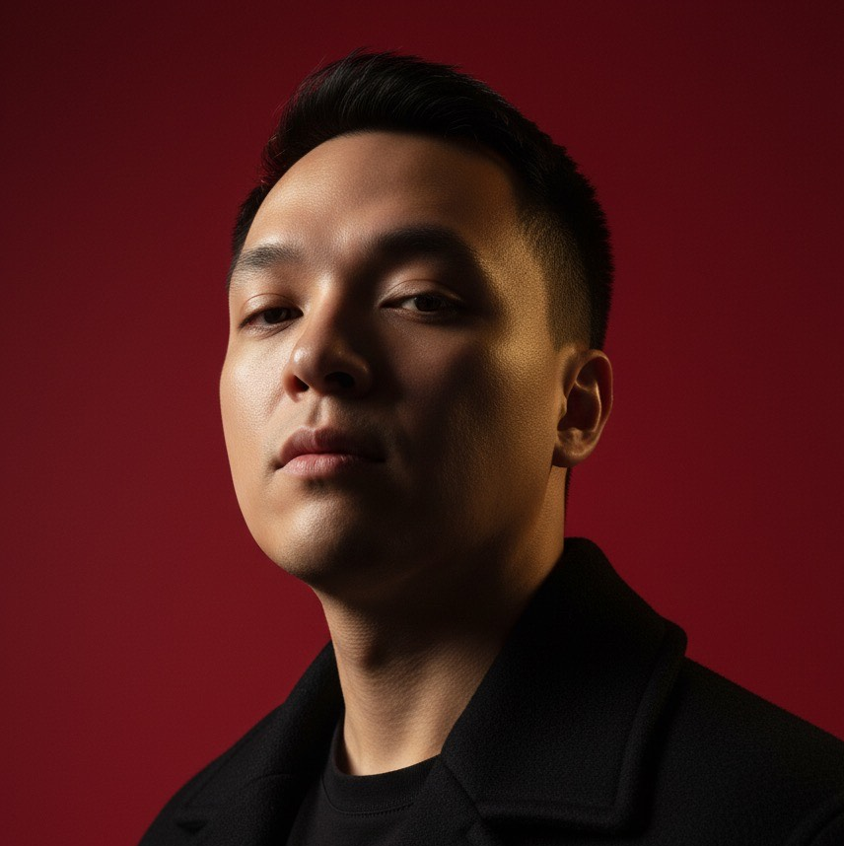


WFM Organizational Chart
MARY LEENA RAYER
Corporate Senior Vice President - Operations
SUMIT KUMAR
Director - WFM
NAVEEN SINGH
Senior Group Manager - WFM
DORIS MARIE AQUINES
Assistant Manager
JHON-JHON BERNARDO
Deputy Manager WFM – Pending For Promotion
DEBASIS MOHANTY
Lead Associate - MIS
MARTIN LUTHER ALVESTER
Assistant Manager
WFM
MICHELLE CABAGBAG Senior Executive - WFM
GERLIE TALASTAS
Senior Associate- WFM
ADRIAN DE VILA
Senior Associate - WFM
MICAH CAMPOMANES
Associate - WFM
CHARMIE GENOZA
Lead Associate - WFM
LESTER EVANGELISTA
Lead Associate - WFM
LESLIE JOY BAGOS
Senior Executive WFM
CARL FERNANDEZ
Senior Executive WFM
LOUGINE DE MESA
Senior Executive - WFM
JOHN FELIX BALINGATA
Senior Executive - WFM
LOUIE GENE BUNDOC
Senior Executive WFM
JUSTINE CONCEPCION
Associate- WFM
MARIO AGPULDO
Lead Associate- WFM
MACK JEROME JOSE
Lead Associate - WFM
CHHRISTIAN AUSTRIA
Senior Associate- WFM
RAPHAEL LASTIMADO
Senior Executive - WFM
JAYNE ANNIEKA SALMORIN
Senior Executive -WFM
ARLENE HACUTINA
Lead Associate- WFM
POC
TREVIPAY
PENNYMAC - CS
PENNYMAC - NON CS

